Slide 1
Activity 1.2.5a Mechanical Efficiency
Winch Construction Guide
Using the
VEX Robotics Platform

Slide 2
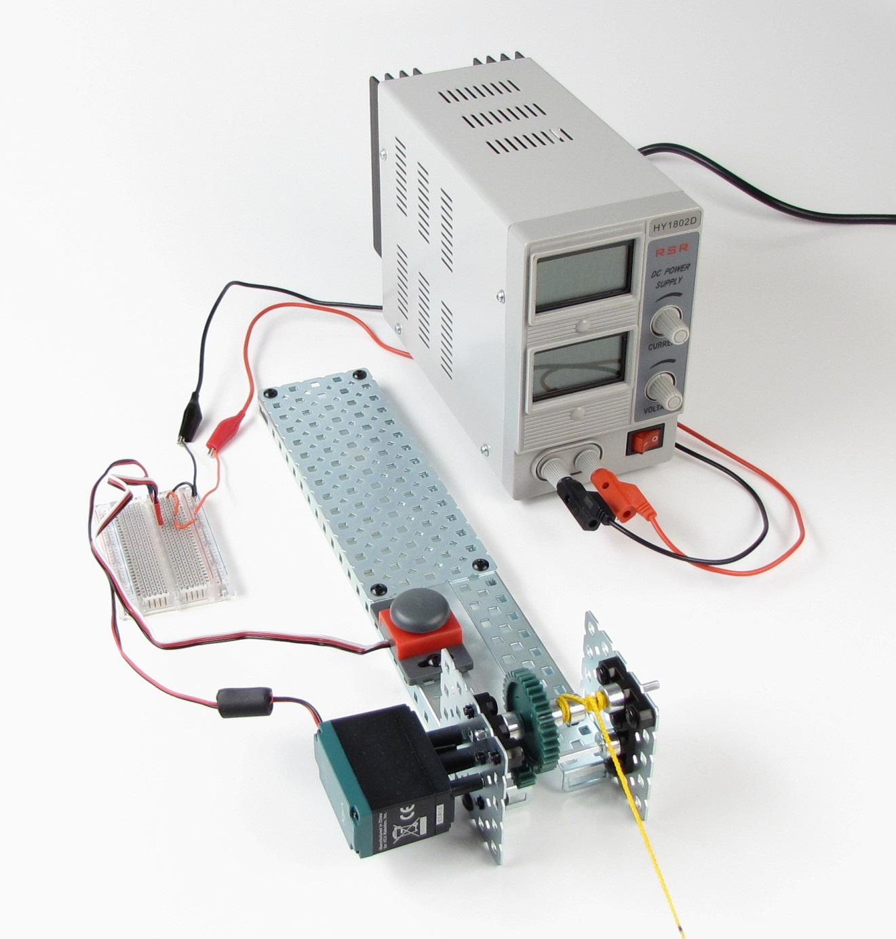
VEX POE kit
Masonry line
Paperclip
Breadboard
Hookup wires
Multimeter

Slide 3
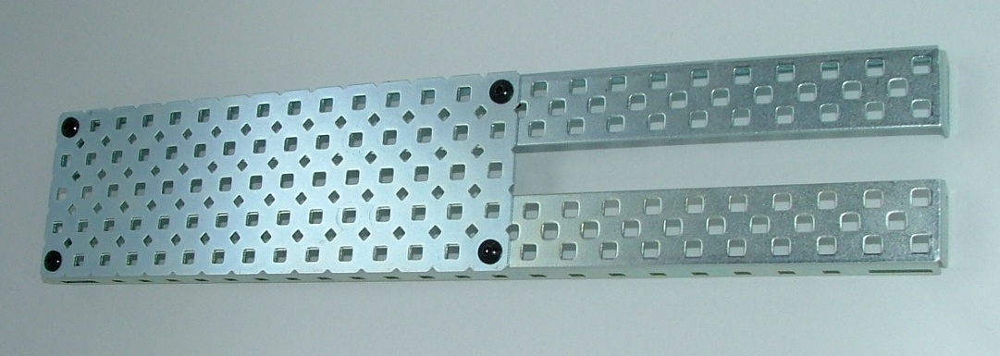
Step 1: Build Base

Slide 4
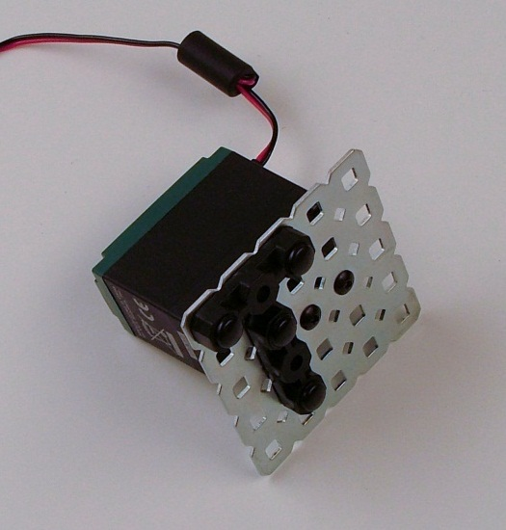
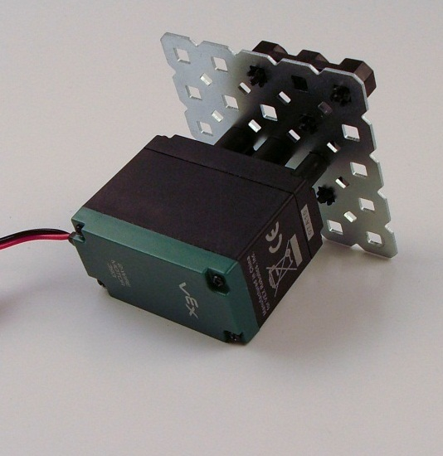
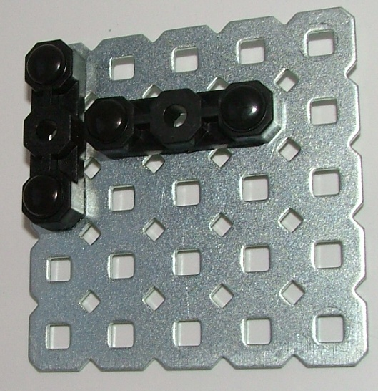
Step 2: Assemble Motor Mount and Shaft Support
2 wire motor
with clutch
Motor mount
front view
Motor mount
back view
Bearing bracket
shaft support

Slide 5
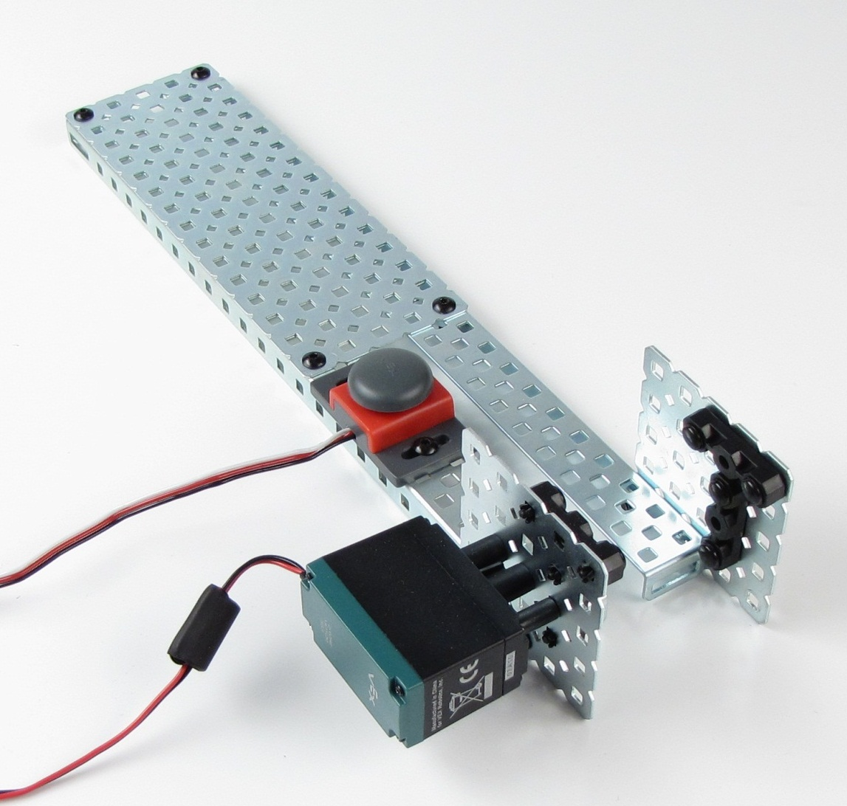
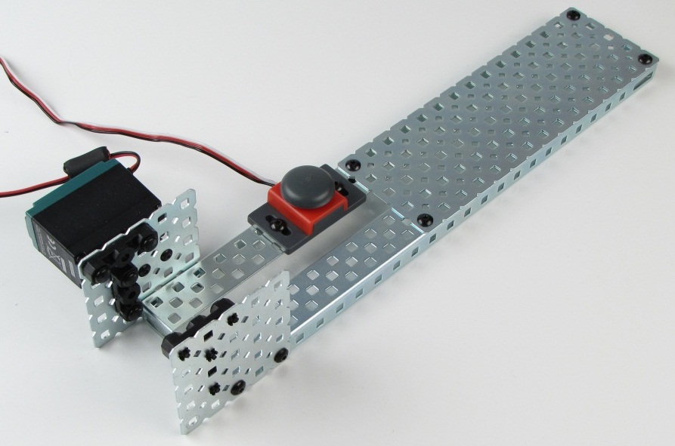
Step 3: Attach Shaft Support Plates and Switch
Alternate view
Plate extends
past end

Slide 6
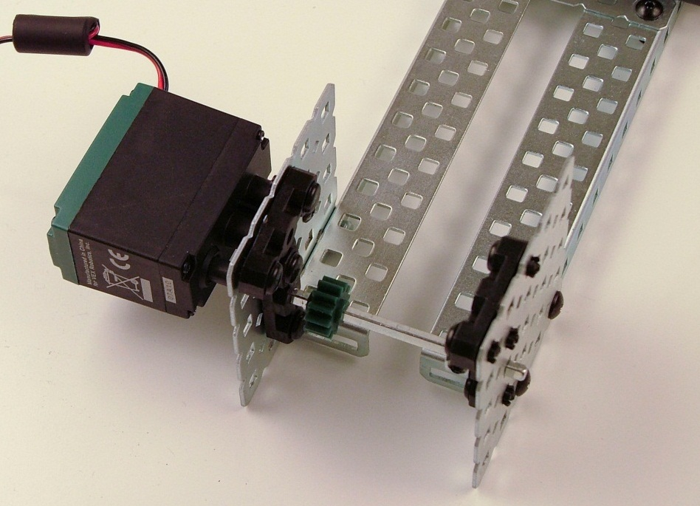
Step 4: Attach Drive Shaft
1. Insert 3 in. drive shaft from right side bearing
2. Thread 12 tooth gear and collar onto shaft
3. Tighten collar onto shaft

Slide 7
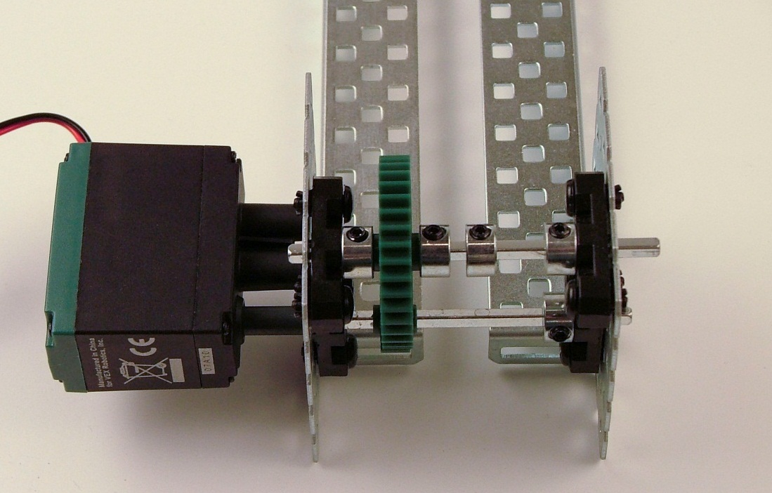
Step 5: Attach Winch Shaft
36 tooth gear
1/8 in. gap

Slide 8
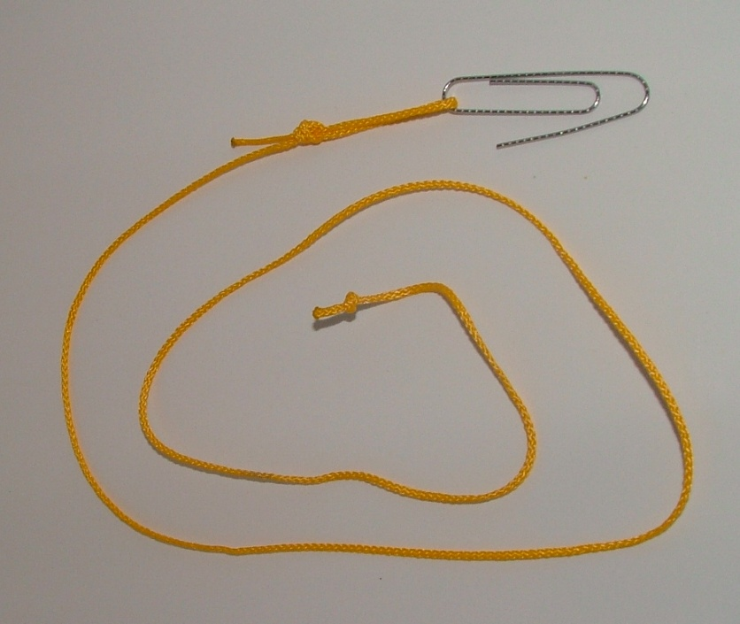
Step 6: Build Winch Cable
Overhand knot
40cm cable

Slide 9
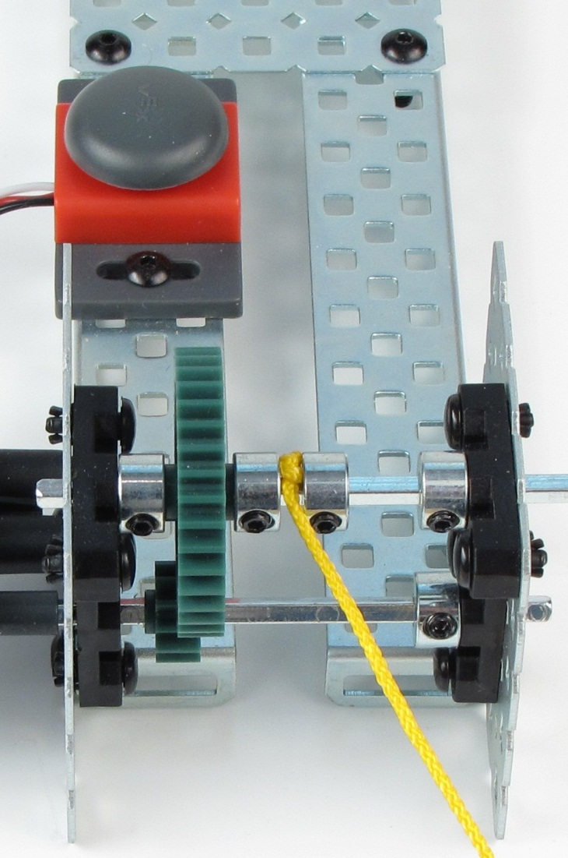
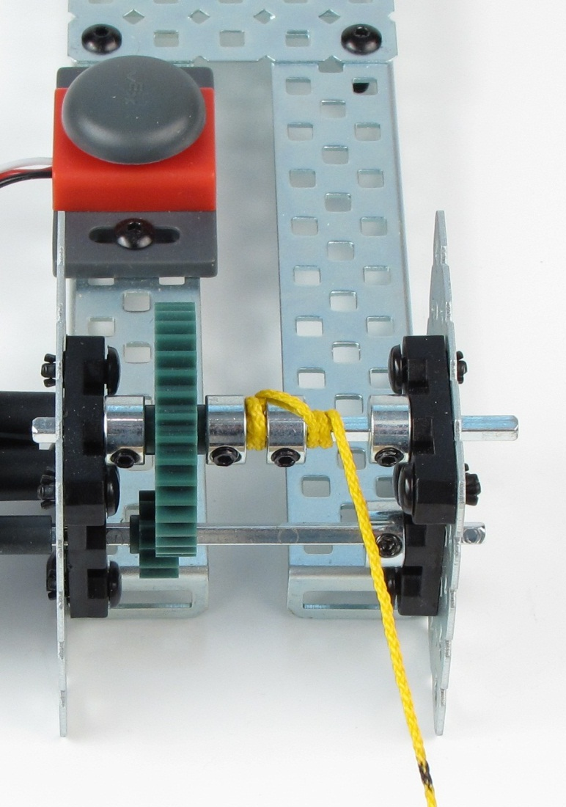
Step 7: Attach Winch Cable
Insert knot between collars
Wind around shaft to fill 1/8 in. gap first
Cross over collar and start winding shaft
To help winding, loosen lower shaft collar to disengage gears

Slide 10
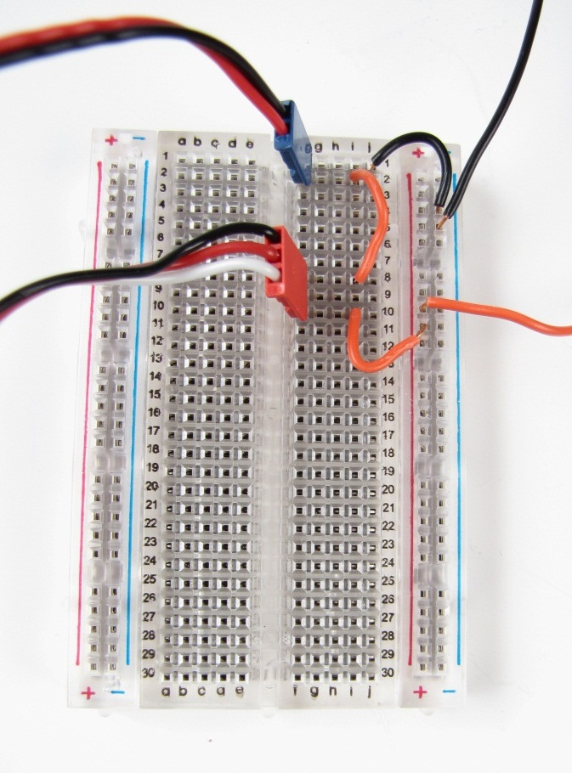

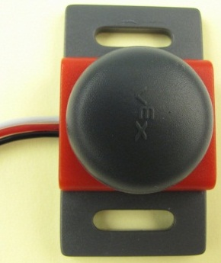
Step 11: Connect Winch to the Power Supply
Motor
Power
supply
Bump
switch
(see below)
Black is used
NOT USED
White is used
White wire
Black wire
Switch schematic

Slide 11
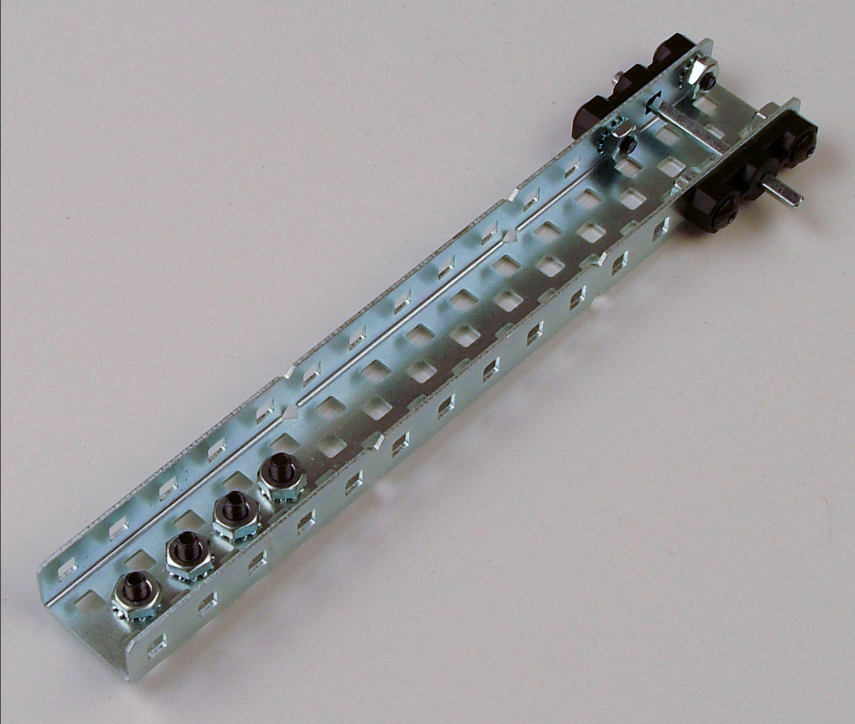
Step 12: Construct Two Weights for Winch to Lift

Slide 12

Stop
Complete
Activity 1.2.5 Mechanical Efficiency

